Slide 1
Chapter1.1: PHP OOP
Passerelles numériques
A Gateway for Life
Lesson 03: Abstract Classes and Interface

Slide 2
Abstract Classes
An abstract class is a class with or without data members that provides some functionality and leaves the remaining functionality for its child class to implement. The child class must provide the functionality not provided by the abstract class or else the child class also becomes abstract.
Objects of an abstract and interface class cannot be created i.e. only objects of concrete class can be created
To define a class as Abstract, the keyword abstract is to be used e.g. abstract class ClassName { }

Slide 3
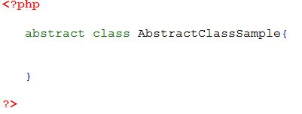
Abstract Classes

Slide 4
Abstract Properties and Methods
Abstract method must use “abstract” keyword.
Abstract method has only method name but no body (implementation).
Private methods cannot be Abstract method
If abstract method declare as protected method that implements must define as public or protected.

Slide 5
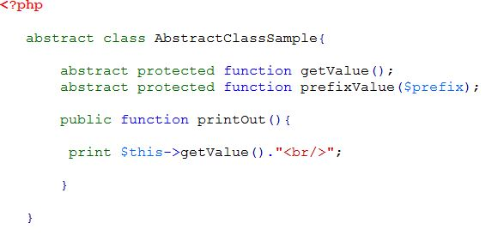
Abstract Properties and Methods

Slide 6
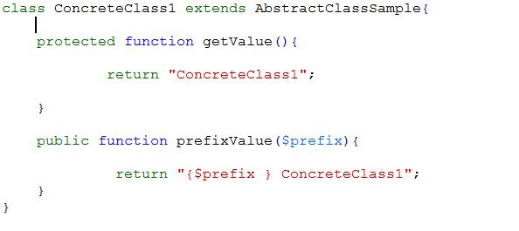
Abstract Properties and Methods

Slide 7
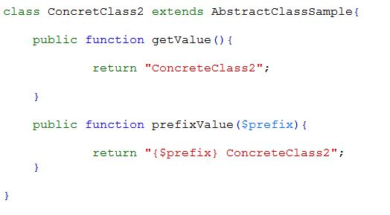
Abstract Properties and Methods

Slide 8
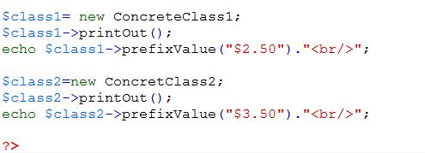
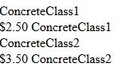
Abstract Properties and Methods

Slide 9
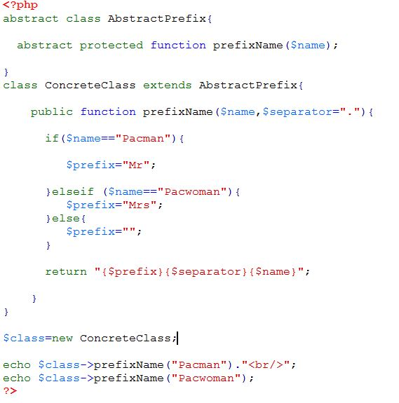


Slide 10
Interfaces
Interfaces allow you to create code which specifies which methods a class must implement, without having to define how these methods are handled.
Interfaces are defined using the interface keyword, in the same way as a standard class, but without any of the methods having their contents defined.
All methods declared in an interface must be public, this is the nature of an interface.
All class can use interface must use implements keyword.

Slide 11
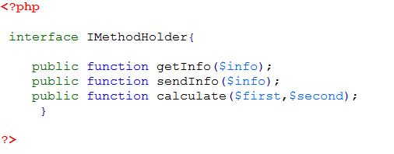
Interfaces

Slide 12
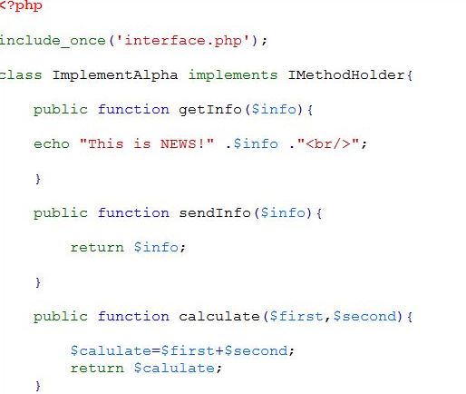

Slide 13
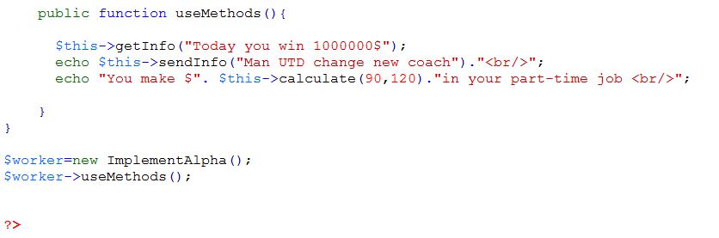


Slide 14


Slide 15
Exercise
Write a program to calculate area of square, Rectangular and circle using interface.
Square area = corner x corner
Rectangular area= long x width
Circle area= R² x 3.14
Write a program to calculate interest AEON. Miss Phors borrowed money from AEON 870$ to buy motor Suzuki Smash V 2014 with interest rate 1.9% per month with duration 12 months. Suzuki Smash V 2014 price 1470$ but she has money only 600$.
Total Money to pay for AEON
Money Payment per every month
Total Interest

Slide 16
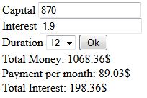

Slide 17
The END

